Slide 1

Capstone Final Presentation

Slide 2





Team 6
Shivam Dwivedi
Modeling
Data gathering
Presentation Preparation
Jason Liao
Executive Summary
Data gathering
Presentation preparation
Cynthia Qiu
Data Visualization
Modeling
Presentation preparation
Doris Xiong
Data cleaning
Modeling
Presentation preparation
Zhijing Zhang
Data gathering
Modeling and coding
Presentation preparation

Slide 3
Introduction
1. Project Overview:
This project explores the influence of macroeconomic variables and time persistence on credit risk, with a specific focus on delinquency rate.
2. Project Description:
The problem this project explores is the influence of macroeconomic variables and time persistence on credit risk, with a specific focus on delinquency rate. Employing quarterly data of the United States from 1991.1 to 2023.4, this project aims to observe the impact of GDP, unemployment rate, interest rate and inflation rate on delinquency rate. The study of macroeconomic determinants of credit risk can provide some insights for the impact of policy.

Slide 4
Agenda
Motivation and Literature Review
Data and Data Visualization
Macroeconomic data
Delinquency rate
Correlation heatmap
Methodology
Result Analysis
Regression result
Prediction result
Conclusion
Individual Reflection

Slide 5
Motivation and Literature Review

Slide 6
Motivation
Recent years have witnessed significant volatility of macroeconomic conditions, which may influence borrowers’ ability to repay loans. It can be partly represented by the delinquency rate, which is the proportion of loans that are past due time. Examining the correlation of macroeconomic variables and credit risk can inspire people about how economic environment impacts credit risk.
Understanding how the past delinquency rate influences the likelihood of future delinquent issue also provides insights for the trends in credit risk dynamics over time.

Slide 7
Literature Review
Previous econometric literature focuses more on non-performing loans (Castro, 2013; Koju et al., 2020) and its conditions in European countries (Castro, 2013; Carvalho et al., 2020). Some of the literatures (Castro, 2013) merged time persistence in the credit risk structure, which provides insights for this project.
What we do:
Use delinquency rate as a measurement, which differentiate from the previous studies
Combine macroeconomic variables with time series model

Slide 8
2. Data and Data Visualization

Slide 9
Data Sources
Federal Reserve Economic Data (FRED)
Provides a wealth of economic data and information to promote economic education and enhance economic research.
Delinquency Rates, GDP, Unemployment rate
Organization for Economic Cooperation and Development (OECD)
Offers statistics and data across multiple countries, providing a platform to compare economic performance.
Interest rate, Inflation rate (CPI)

Slide 10
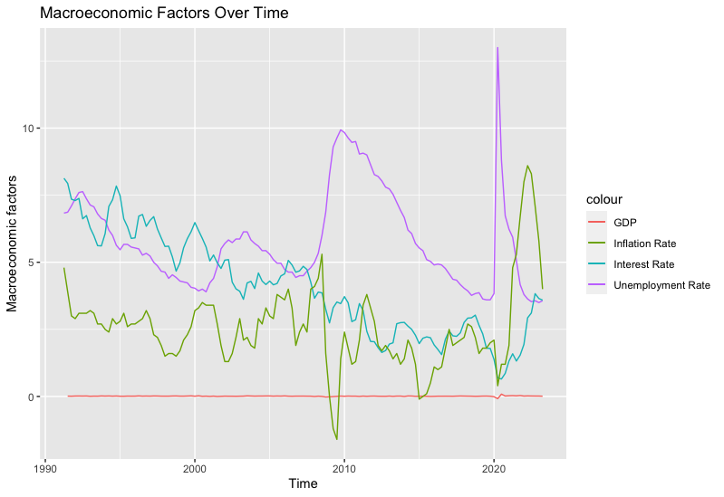
Macroeconomic Data
Macroeconomic Variables:
Quarterly data of GDP, Interest rate, Unemployment rate, and Inflation rate
Time Range: 1991.1 - 2023.4
Macroeconomic Factors Trend Plot:
Outliers appear in 2008-2009 and after 2020, which indicates the financial crisis and COVID periods.
Upward trend of GDP & downward trend of interest rate

Slide 11
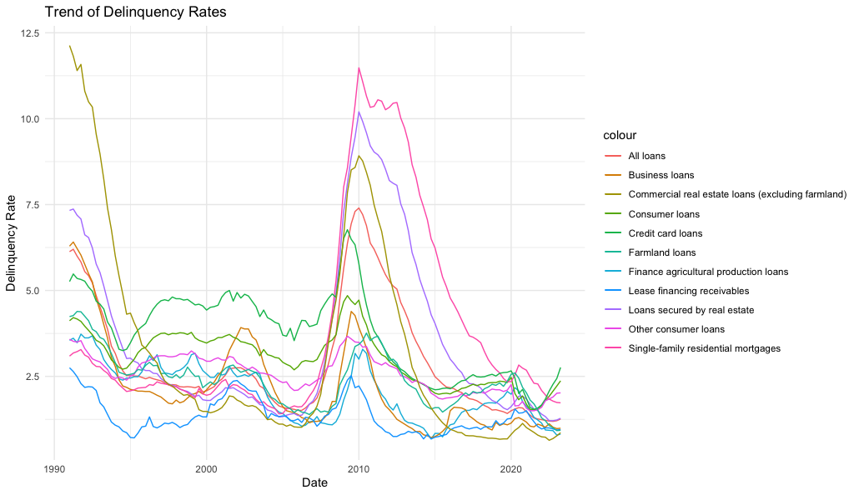
Credit Risk: Delinquency Rate
Credit Risk Measurement:
Quarterly delinquency rate of different loans in commercial bank from 1991.1-2023.4
Similar trend among different loans
Peak appears during 2008-2009 financial crisis.

Slide 12
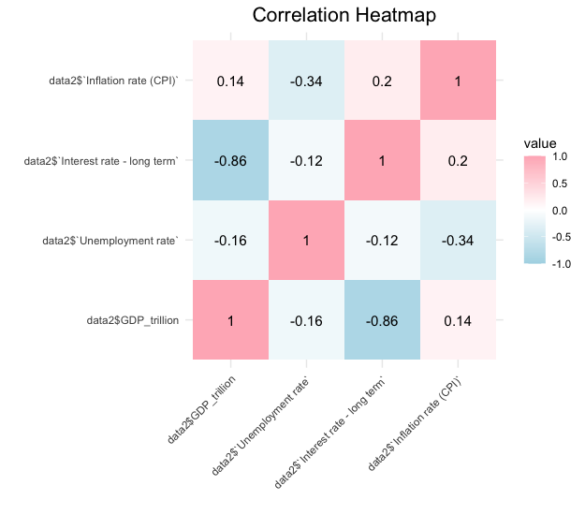
Correlation Heatmap
Correlation Heatmap:
Includes GDP, unemployment, interest rate, inflation rate
Significant correlation exists between GDP and interest rate

Slide 13
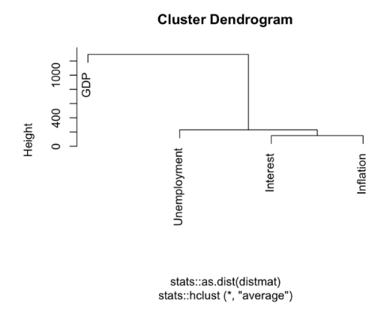
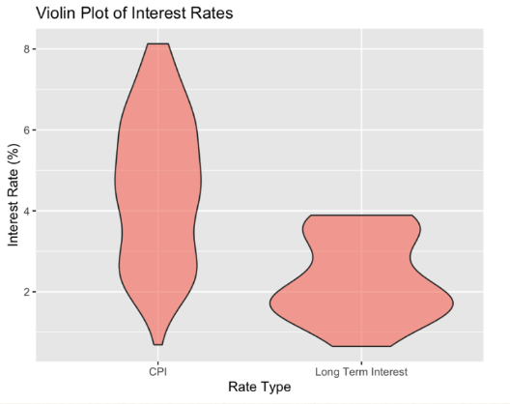
Cluster Formation
Cluster Dendrogram:
GDP stands as an independent branch
Unemployment and Interest form a smaller cluster initially, then join with Inflation to create a larger cluster.
Violin Plot:
CPI-Related Interest Rates:
Wider distribution range indicates higher fluctuation
Long-Term Interest Rates:
Narrow distribution reflects comparative stability
Concentrated at lower rate levels

Slide 14
3. Methodology

Slide 15
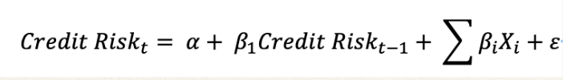
Methodology
Time Series Model
Delinquency rate is used as measurement for credit risk, using delinquency rate of previous period to predict the delinquency rate of next period
X stands for different macroeconomics variables (GDP increase rate, unemployment, interest rate, inflation rate)
GDP was first chosen as one variable, but the results seem to be statistically insignificant, so we transfer it to GDP increase rate.

Slide 16
Methodology
Predictive Model
Using data from 1991.1 to 2023.4, regression model of each loan is constructed.
We gathered quarterly macroeconomic data of 2023.7 and 2023.10, and use the regression formula to predict delinquency rate of the last two quarters of 2023 and compared with the actual delinquency rate of these quarters.

Slide 17
4. Result Analysis

Slide 18
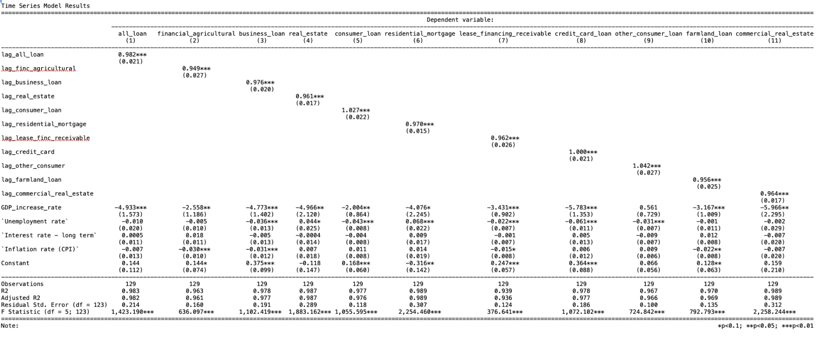
Regression table

Slide 19
Regression Results
Delinquency rates of all kinds of loans show statistically significant correlation with delinquency rate of next period. And the coefficient for delinquency rate of last period is always around 1, which shows a positive correlation.
interpretation: if the delinquency rate of this period is high, it is likely that the delinquency rate of next period would also be high.
Among the macroeconomic variables, GDP increase rate, unemployment rate and inflation rate have statistically significant correlation with credit risk.
interpretation:
macroeconomic environment can influence loan market
different types of loans have different levels of sensitivity

Slide 20
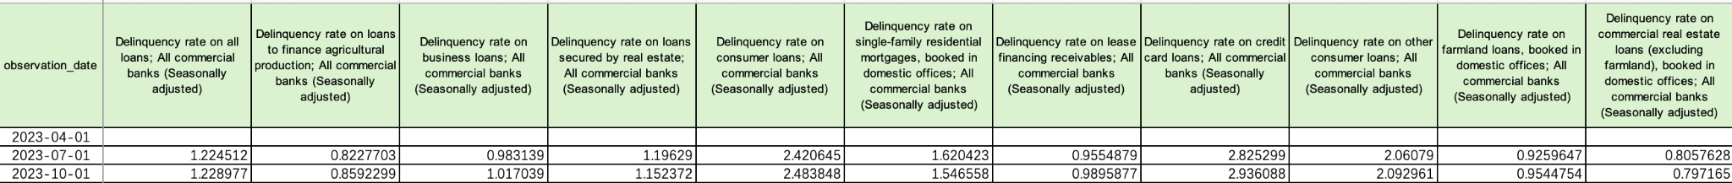
Prediction Results
We used the regression results and the macroeconomic data to predict delinquency rate of next two quarters. Comparing the results with the actual delinquency rate, we found the predictive result underestimates about 0.1% for the third quarter of 2023 and underestimates about 0.15% for the last quarter of 2023.
Potential reasons:
the model cannot capture the external factors that may influence credit risk, for instance, policy change may influence delinquency rate
the model may miss some macroeconomic variables that have correlation with credit risk.

Slide 21
5. Conclusion

Slide 22
Conclusion
What we learned
Impact of macroeconomic variables: economic downturns, high unemployment and inflation may increase credit risk.
Time series model: evidence indicating that past delinquency rate can be used as predictor for future delinquency rate

Slide 23
Limitations and Future Research
Limitations:
Time effects: This project only focuses on quarterly data, so chances are that the results would be more precise if it can be changed to monthly or even weekly data.
Selection bias: The macroeconomic variables selected are intuitively correlated with credit risk, which means that we may omit some variables that are potentially correlated with credit risk.
Future Study:
Dynamic variable selection
Policy impact analysis

Slide 24
Thanks for Listening!

Slide 25
Reference
Castro, V. (2013). Macroeconomic determinants of the credit risk in the banking system: The case of the gipsi. Economic Modelling, 31, 672–683. https://doi.org/10.1016/j.econmod.2013.01.027
Carvalho, P. V., Curto, J. D., & Primor, R. (2020). Macroeconomic determinants of credit risk: Evidence from the eurozone. International Journal of Finance &amp; Economics, 27(2), 2054–2072. https://doi.org/10.1002/ijfe.2259
Koju, L., Koju, R., & Wang, S. (2019). Macroeconomic determinants of credit risks: evidence from high-income countries. European Journal of Management and Business Economics, 29(1), 41–53. https://doi.org/10.1108/ejmbe-02-2018-0032

Slide 26
Q & A Time
zz231@duke.edu; cynthia.qiu@duke.edu; doris.xiong@duke.edu; jason.y.liao@duke.edu; shivam.dwivedi@duke.edu

